Slide 1
K-means Clustering Algorithm

Slide 2
Topics
Motivation
Supervised vs Unsupervised Learning
What is Clustering?
K-means Objective
K-means Algorithm
Choosing the Appropriate Number of Clusters
How to Apply? – Source Code

Slide 3
Motivation
The k-means clustering method is an unsupervised machine learning technique used to identify clusters of data objects in a dataset

Slide 4
Motivation
K-NN
K-means
Used in statistics and It is a non-parametric machine learning method and kind of supervised machine learning
It is used for classification and regression
Method of vector quantization, originally from signal processing, that aims to partition (n) observations into (k) clusters in which each observation belongs to the cluster with the nearest mean (cluster centers or cluster centroid)

Slide 5
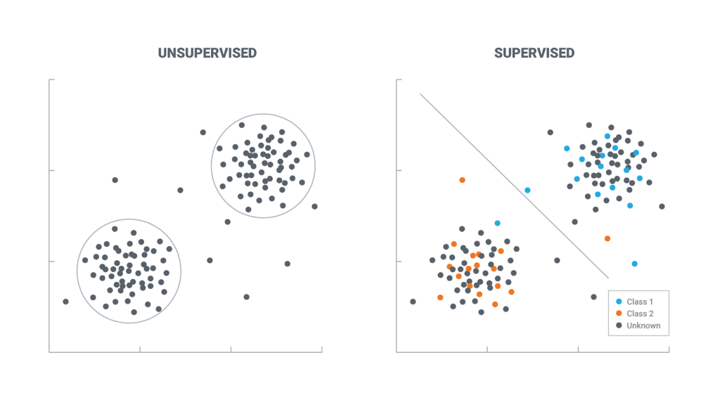
Supervised vs Unsupervised Learning
Notes:
Supervised Learning: is where you have input (x) and an corresponding output (y)
Unsupervised Learning: is where you have input (x) and no corresponding output

Slide 6
What is Clustering?
Clustering is a set of techniques used to partition data into groups, or clusters
Partitional Clustering
Hierarchical Clustering
Density-based Clustering
Notes:
Partitional clustering divides data objects into non-overlapping groups.
Hierarchical clustering determines cluster assignments by building a hierarchy. This is implemented by either a bottom-up or a top-down approach:
Density-based clustering determines cluster assignments based on the density of data points in a region. Clusters are assigned where there are high densities of data points separated by low-density regions.

Slide 7
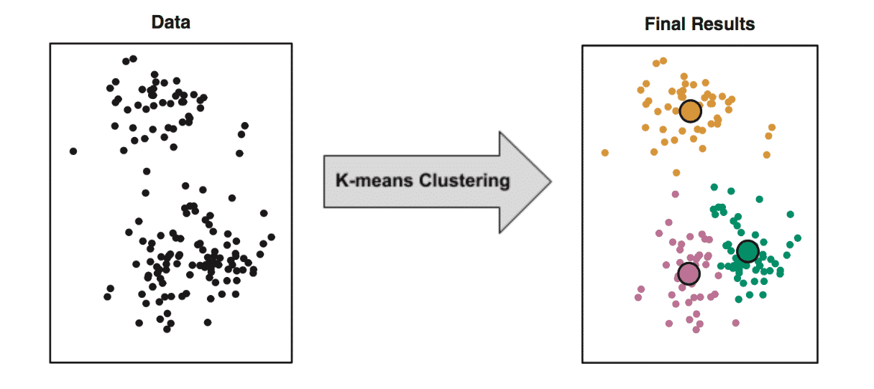
K-means Objective

Slide 8
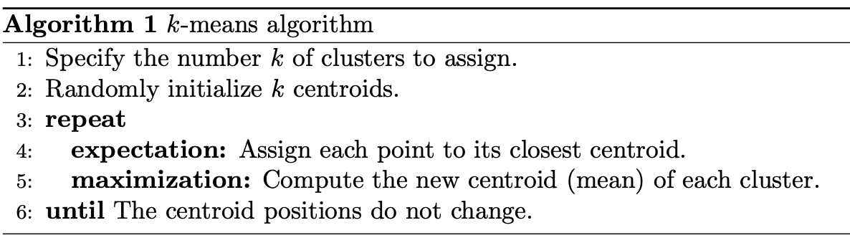
K-means Algorithm

Slide 9
K-means Algorithm

Slide 10
K-means Algorithm
The quality of the cluster assignments is determined by computing the sum of the squared error (SSE) after the centroids converge

Slide 11
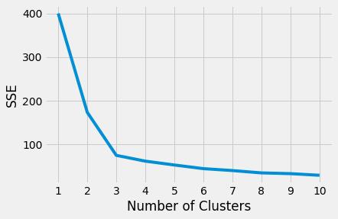
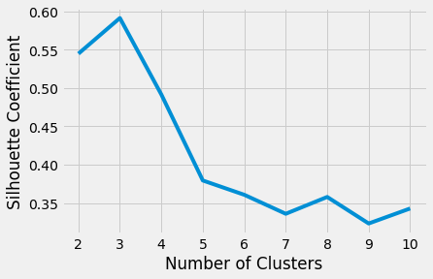
Choosing the Appropriate Number of Clusters
The elbow method
The silhouette coefficient

Slide 12
How to Apply? – Source Code
Using sklearn library in Python
GP Example:
from sklearn.cluster import Kmeans
from sklearn.metrics import silhouette_score
kmeans = KMeans(n_clusters = 3, random_state = 0).fit(tsne3)
kmeans_tsne3 = kmeans.fit_transform(tsne3)

Slide 13


